Slide 1
Collaborative Multi-Agent Learning
Kevin Lee, Parnika Jain, Sijie Dai

Slide 2
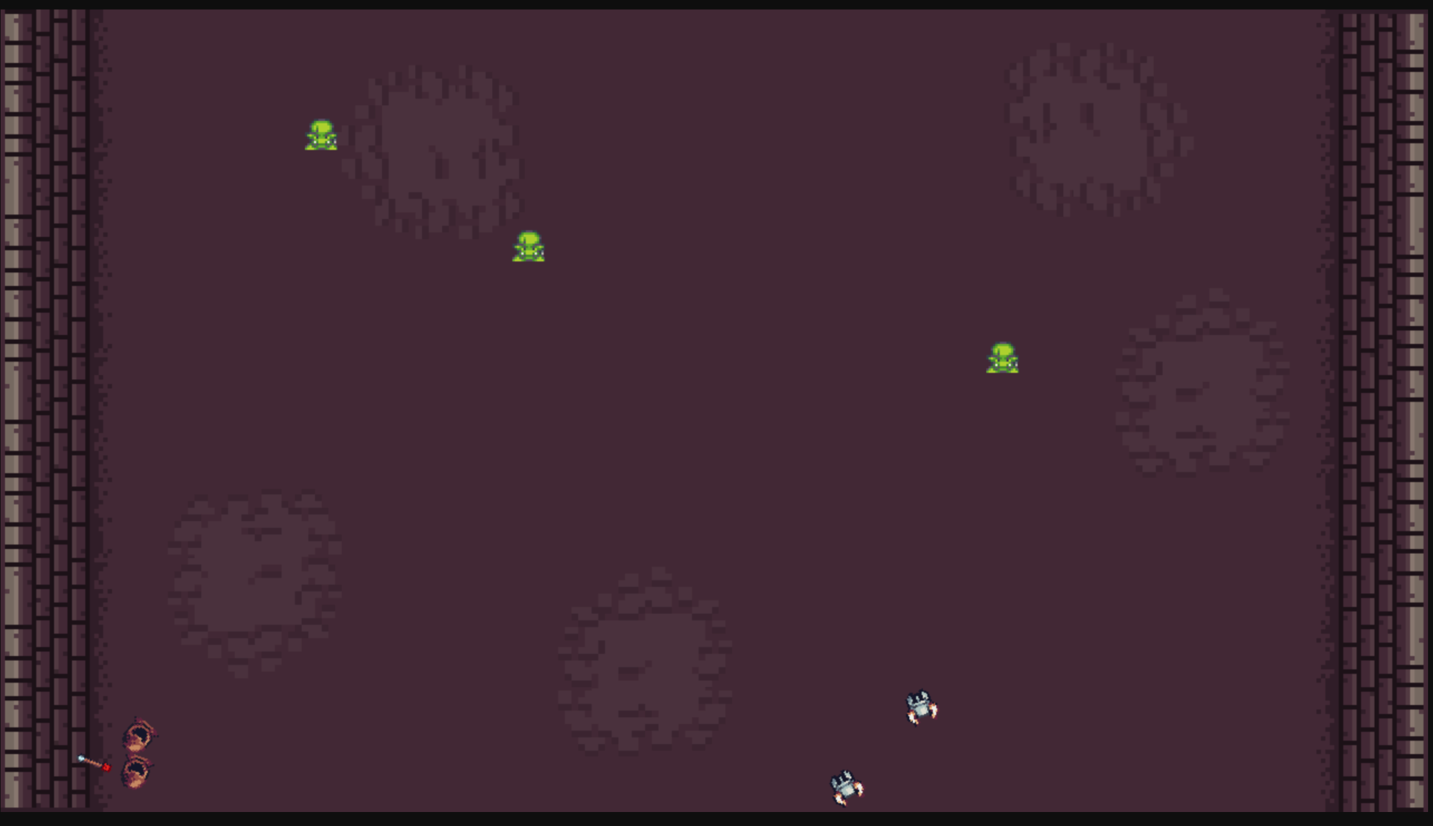
Introduction
Deep Q learning is a powerful way to help program game agents to make optimal decisions in complex environments
It combines the use of deep neural networks with Q-learning to help agents develop strategies.
What about situations with multiple game agents?
Knights Archers Zombies is a game where there are 2 of each trainable agent
Knights and Archers defeat zombies
Centralized training with decentralized execution approach to approach multi-agent cooperative learning

Slide 3
Multi-Agent Reinforcement Learning
A subfield of reinforcement learning where there are multiple trainable agents in an environments
Each agent's actions can influence not only its own state and rewards but also those of other agents
Related algorithms attempt to address issues regarding training agents in non-stationary environments
Highly applicable in real work scenarios, with dynamic, non-deterministic environment

Slide 4
Project Explanation
Multi agent reinforcement studies the behaviour of multiple agents in an environment
When training a model to play the game, we wanted the, agents to learn how to collaborate with each other
Initially, we took an individual DQN approach, where each agent is independently
Through our research, we discovered the concept of CTDE
In CTDE, agents are trained using a centralized approach, where the training process considers the overall environment and interactions between agents. Agents might not have full access to a global state but are trained with awareness of the environment and other agents.
During the execution phase, each agent operates independently, using the policy it learned during the centralized training process.

Slide 5
Potential Issues with Independent Learning
One of the main reasons why centralized training was considered was due to multi agent environments being non-stationary
This can cause issues with the training of IQL models
Individual agent policies change constantly, but this is difficult to observe for each agent due to limited observation space
Another concern is related to limited information access for agents with regard to other agents
This can cause issues with independent learning, where it can lead to suboptimal performance as they don’t take into account behaviour of other agents

Slide 6
Potential Shortcomings of Centralised Training
Single point of failure in main controller would compromise the entire
Scalability can be concern for centralized training algorithms
As number of agents increases, state-action space grows exponentially
Computationally expensive
A centralized controller would need to reprocess and learn over a new space
More information required for decision making
May lead to slow decision making

Slide 7
Our Approach
We initially implemented independent Q learning; a decentralised training algorithm for multiple agents to play KAZ
We implemented a multi-agent DQN approach, where each agent was trained in a shared environment, considering interactions with other agents.
This approach uses a separate Q-network for each agent, focusing on maximizing individual rewards while taking into account the shared environment dynamics.
Joint action-values are not explicitly calculated, but the interaction between agents is inherently captured through the environment’s response to each agent’s actions.

Slide 8
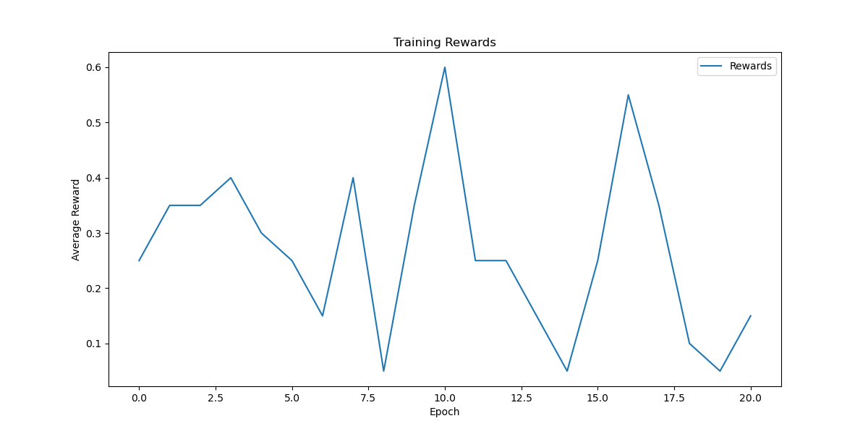
Game Performance: Centralized (reward plot)
Fluctuating Rewards:Eexploration and variability in strategy effectiveness.
Peaks (Epochs 7, 12): Possible discovery of effective strategies.
Troughs (Epochs 10, 15): Challenges or ineffective exploration.
Decline at End: Possible convergence on suboptimal strategy; may need more training.
Next Steps: parameters, analyze agent behavior

Slide 9
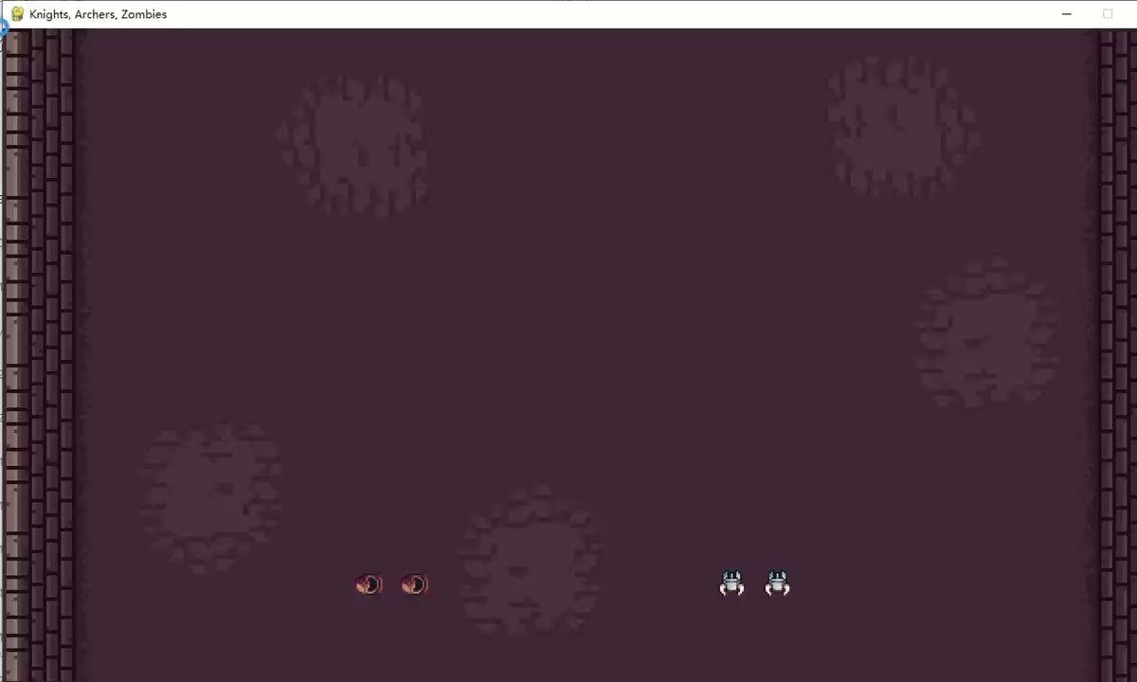
Game Performance: Centralized(Viedeo)

Slide 10
Summary

